Slide 1


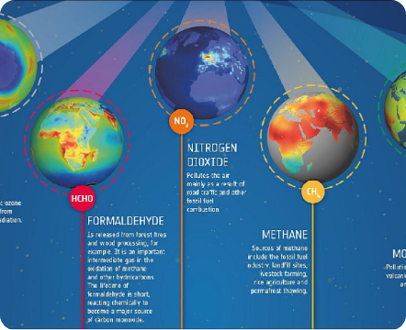
PROJECT ELARA • EARTH OBSERVATION
GCC HACKATHON POC
Satellite Based Emissions Monitoring for the Gulf
Continuous, facility-level air quality tracking powered by Sentinel-5P TROPOMI remote sensing.
Primary Sensor Copernicus Sentinel-5P
Spatial Resolution 3.5 × 5.5 km
Zero Capex Infrastructure

Slide 2



Market Challenge
The GCC Ground Monitoring Gap
Coverage Blind Spots
Detection Lag
Capital Intensity
Sparse surface stations miss vast industrial corridors and offshore platforms.
Ground sensors report local air quality without identifying plume sources.
Physical stations cost tens of thousands per unit, preventing rapid expansion.
Abu Dhabi PM10 Example:
Only 5 primary stations cover the entire metropolitan industrial zone

Slide 3


The Innovation
Project ELARA Solution
1
Zero-Capex Regional Coverage
Scans the entire GCC daily using open-access ESA Sentinel-5P data streams.
2
3.5 × 5.5 km Spatial Precision
Upgraded from legacy OMI resolution to pinpoint specific refineries and ports.
3
Automated Plume Attribution
Combines atmospheric gas densities with temporal models for point compliance.

Slide 4
Target Chemical Species
Atmospheric Gas Portfolio
NO₂
SO₂
HCHO
PM10 / PM2.5
Nitrogen Dioxide
Sulfur Dioxide
Formaldehyde
Particulates
Combustion marker from vehicles, power plants, and oil refining.
Heavy fuel oil combustion, refining operations, and marine shipping.
Petrochemical processing marker and ozone precursor.
Modeled via surface reflectance over unmonitored zones.
Measurement Basis: Tropospheric Column Density integrated vertically (molecules/cm² or µmol/m²)

Slide 5
Observational Literature
GCC Pollution Trends (2005–2023)
+12% Peak Annual NO₂ Surge
-1.7% Post 2018 Policy Shift
+25% Offshore Platform Spike
Urban and industrial expansion across the Middle East (2005–2014).
Annual NO₂ decline in Qatar, Bahrain, and Dammam corridor (2018–2023).
Elevation above background levels under calm wind conditions.
Key Takeaway: Stricter vehicular standards and cleaner power shifts caused regional emissions to peak in ~2018, creating a clear policy evaluation baseline.

Slide 6
Google Earth Engine Pipeline
Technical Workflow
STEP 01
STEP 02
STEP 03
STEP 04
AOI Filter
Data Ingestion
Quality Filter
Trend Analysis
Bounding box across Gulf region (40–60°E, 18–32°N).
Stream S5P OFFL L3 tropospheric NO₂ collections.
Threshold qa_value > 0.75 to remove cloud cover distortion.
Compute multi-year mean composites and percentage deltas.
// Earth Engine Sample: var percentageChange = current.subtract(baseline).divide(baseline).multiply(100);

Slide 7

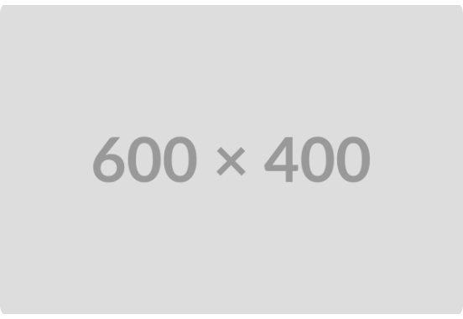
Proof of Concept Output
TROPOMI NO₂ Density Mapping
Regional Hotspot Identification
High concentrations highlighted along major refining hubs and shipping lanes.
Point-Source Differentiation
Separates urban traffic plumes from stationary petrochemical stacks.
Model Accuracy Benchmark
Validated within ~5–15% against ship and surface campaigns (SCOAPE).

Slide 8
Competitive Advantage
Strategic Value Proposition
Monitoring Approach | Spatial Coverage | Deployment Cost | Attribution Detail
Ground Stations | 1-2 km radius around station | $30K-$100K per station | Point specific, but sparse
Manual Compliance Audits | Periodic facility snapshots | High recurring labor | Self-reported, prone to gaps
Generic Air Quality Apps | City-wide regional averages | Low software cost | No facility attribution
Project ELARA Engine | Full GCC Regional Footprint | Near Zero Hardware Capex | Facility Level (3.5 × 5.5 km)

Slide 9
Market Alignment
Target Customer Ecosystem
Environmental Regulators (B2G)
Oil & Gas Operators (B2B)
Regional hotspot dashboards and automated compliance alert systems.
Self-monitoring reports and early plume leak detection prior to fines.
Industrial Insurers
ESG Consultancies
Historical emissions trend analytics for liability risk pricing.
Independent third-party satellite verification modules.

Slide 10
Commercial Model
Revenue Architecture
TIER 01
TIER 02
TIER 03
Public / Freemium
B2G Subscription
B2B Operator SaaS
Free city-level air quality index maps to build trust and market awareness.
Annual contracts for regional dashboards, alert APIs, and policy reports.
Private facility dashboards with automated compliance reporting.
$0 (Lead Gen)
Annual Enterprise License
Monthly / Site Tier
Initial TAM: 50–150 Major Industrial Facilities Across 6 GCC States
Lean Cost Base: Zero Raw Data Capex

Slide 11
Execution Strategy
Technical Roadmap
PHASE 01 • MVP & VALIDATION
PHASE 02 • MULTI-GAS EXPANSION
PHASE 03 • PILOT DEPLOYMENT
Wind Integration
Methane & SO₂ Modules
Commercial Pilot
Incorporate ERA5 wind vectors to trace plume origin and cross-validate against surface stations.
Incorporate CH₄ plume detection and integrate hyperspectral data streams.
Deploy live monitoring dashboard with a regional regulator or oil operator.

Slide 12

PROJECT ELARA • JUDGING DEFENSE
SUMMARY
"Turning free satellite data into continuous, facility-level emissions records — without installing a single sensor."
Regulators & Operators Clear Paying Customers
Fraction of Capex High ROI vs Physical Sensors
GCC-Wide Scale Immediate Footprint
Project ELARA • Environmental Observation Engine
Ready for Live Prototype Demo

Slide 13

Image Sources
https://www.eoportal.org/api/cms/documents/d/eoportal/s5p-2020_auto56-jpeg
Source: www.eoportal.org

